Slide 1
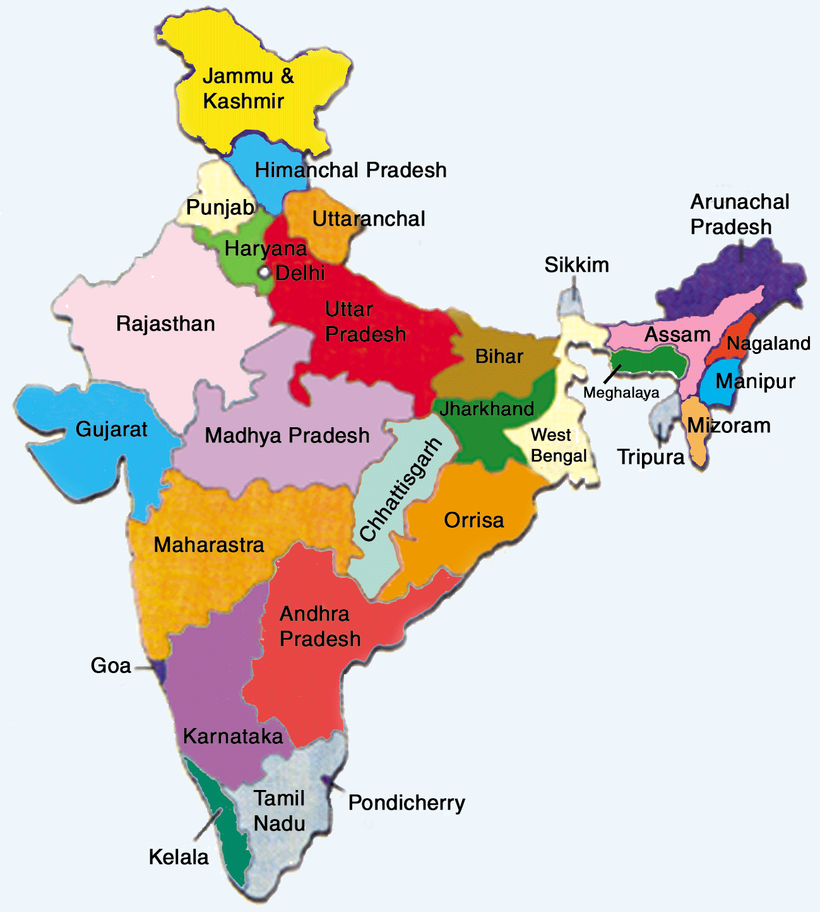
WELCOME
RIM - INDIA
REACHING THE MOST UNREACHED TRIBES Of INDIA
India has 28 States and 9 Union Territories
Total villages in India are 640,930
India has 766 districts in India
The below table shows the number of
villages of One of the Districts of Odisha.

Slide 2
RIM – Reaching the Unreached Tribes of India
ABC
Adopt a benighted Child
KIT
(Kingdom Intentive Teachings)
GEMS
(Global Evangelical Mission Seminary)
Church Planting

Slide 3
RIM – Reaching the Unreached Tribes of India
Urgency
ABC Program
In progress
Priority
1, 2, 3 Days Training
Non-certified
Necessary
GEMS
Residential/Long term Training/Coaching
1, 2, 3 Years Program
Certified Training
KIT
(Kingdom Intentive
Teachings)
Short Term Trainings

Slide 4
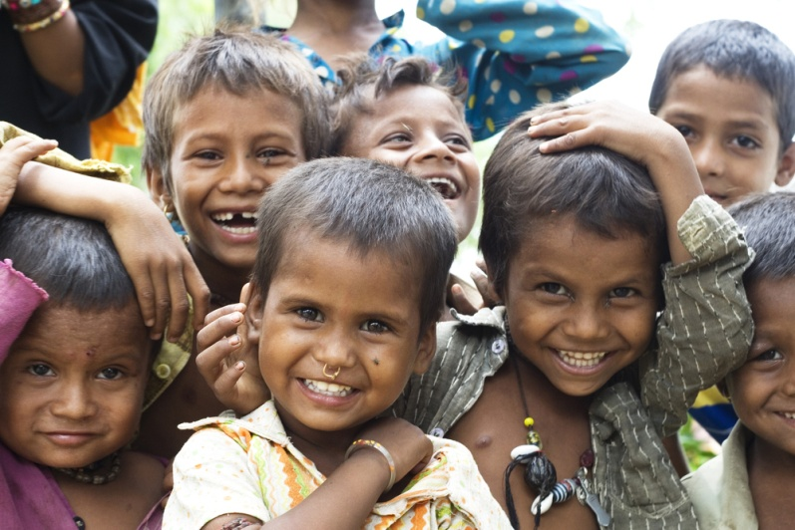
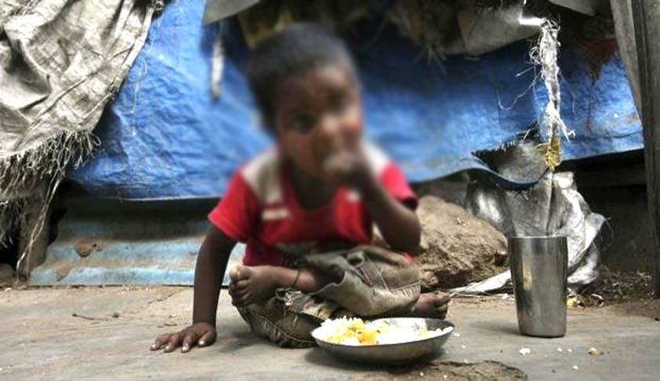
RIM – Reaching the Unreached Tribes of India
-Child labor should be
Stopped.
-Child marriages should
be stopped.
-Education be encouraged
ABC
PROGRAM

Slide 5
RIM – Reaching the Unreached Tribes of India
ADOPT A BENIGHTED CHILD
One family - One Child
ABC
PROGRAM
SHELTER
FOOD
CLOTHING
SCHOOLING

Slide 6
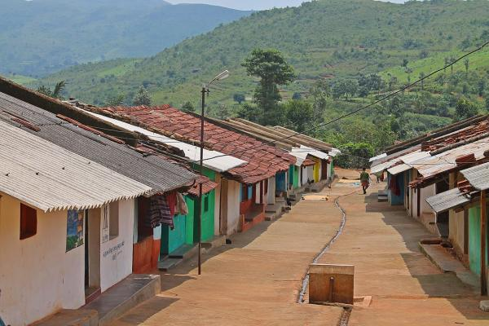
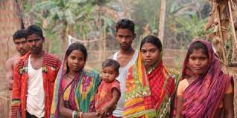
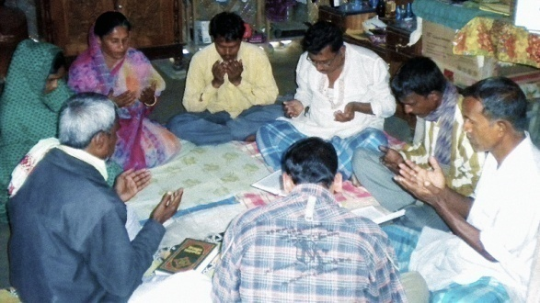
RIM – Reaching the Unreached Tribes of India
Access to the Village
Access to the Community
Select a Child
ABC
PROGRAM
House Church

Slide 7
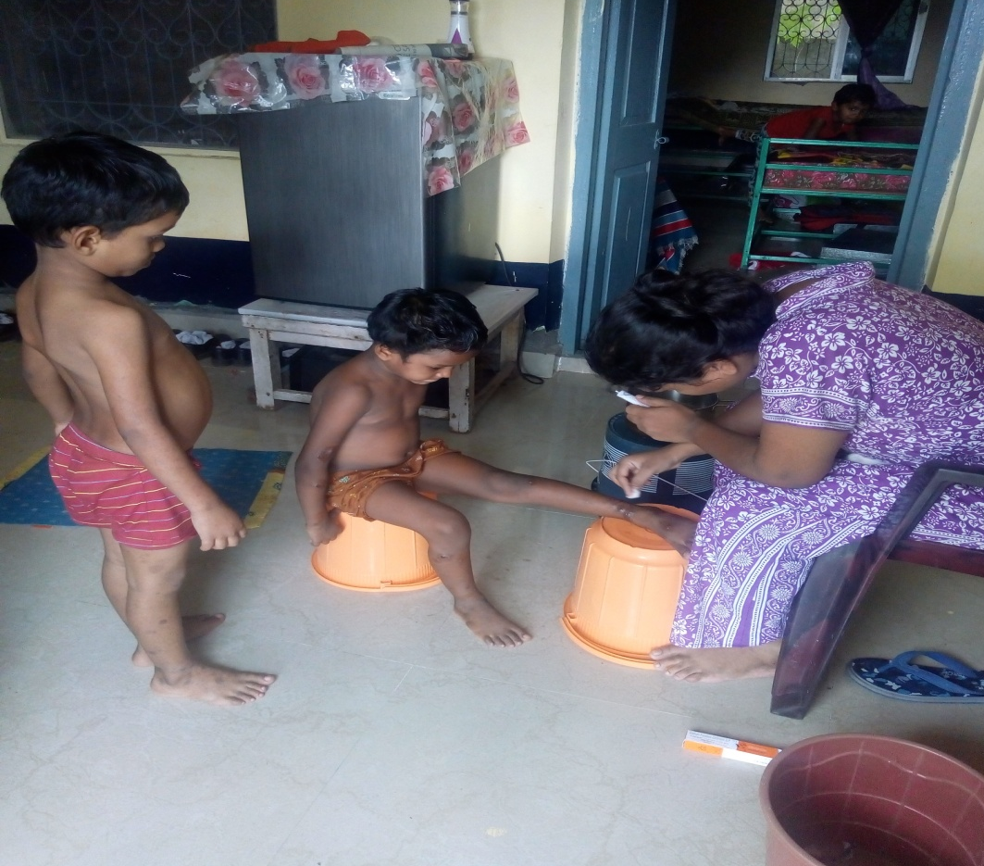
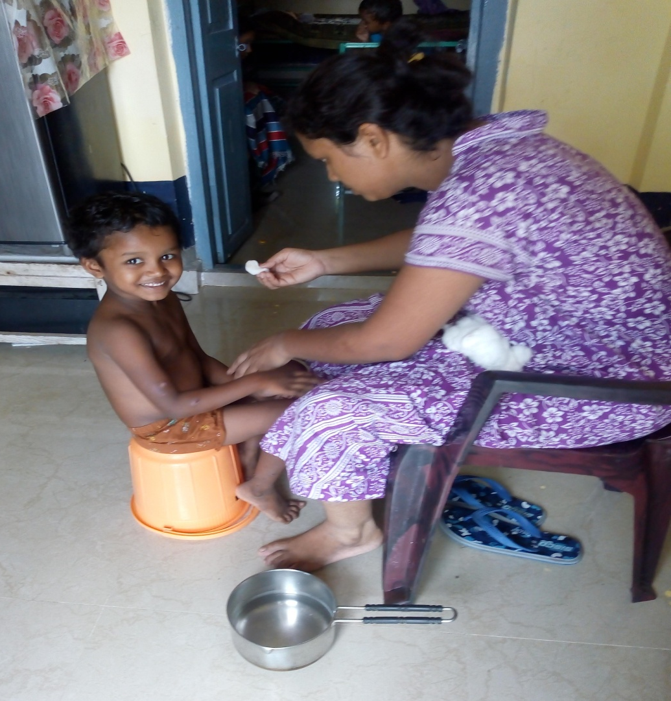
RIM – Reaching the Unreached Tribes of India
ABC
PROGRAM
Transformation Process - 1

Slide 8
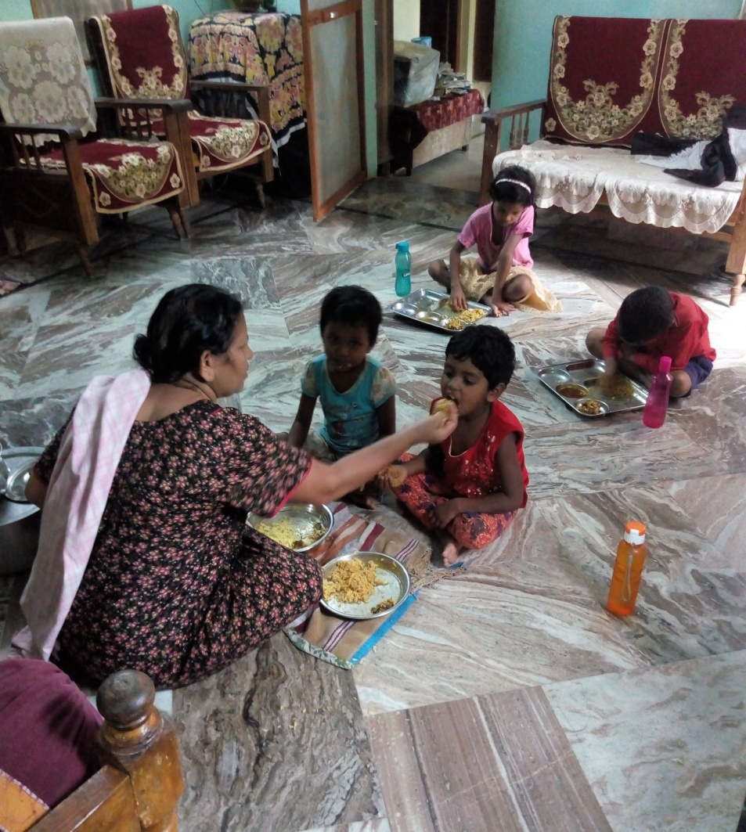
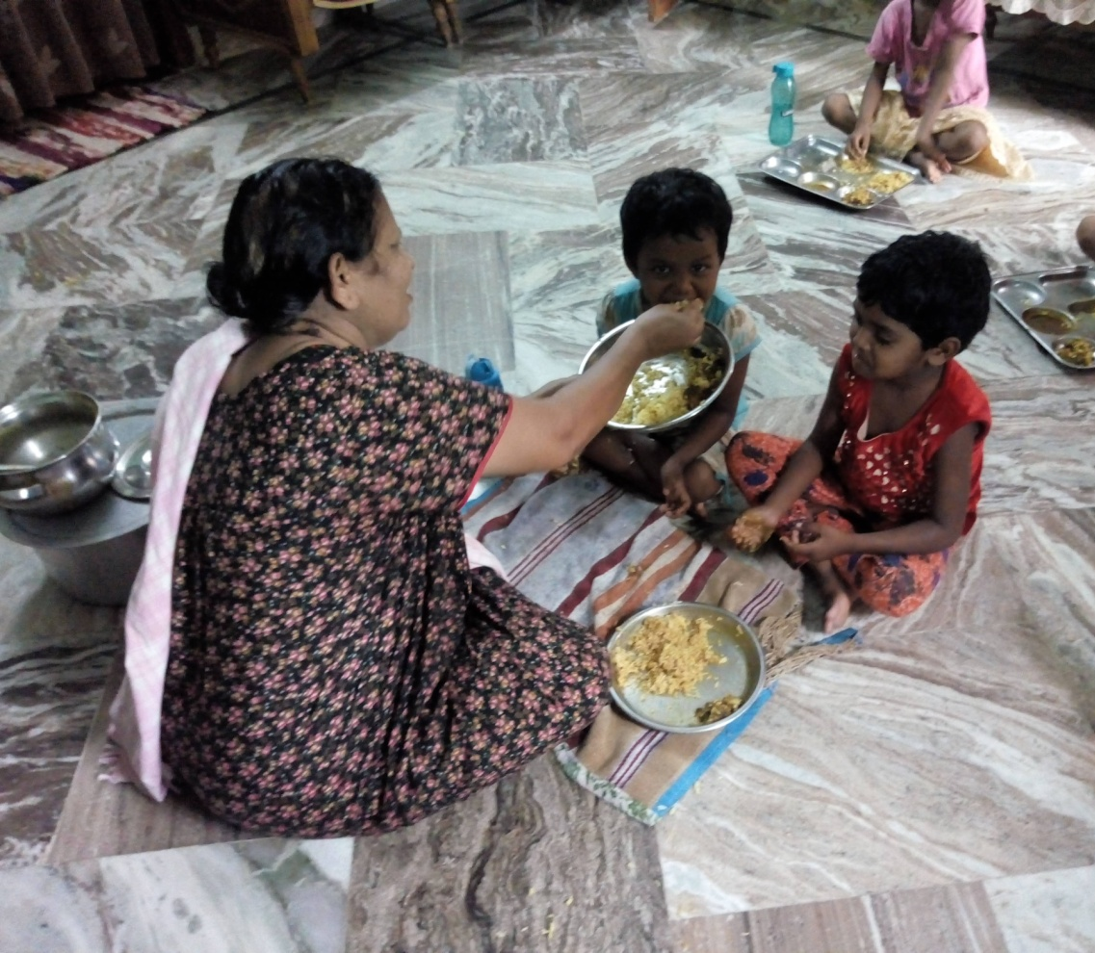
RIM – Reaching the Unreached Tribes of India
ABC
PROGRAM
Transformation Process - 2

Slide 9
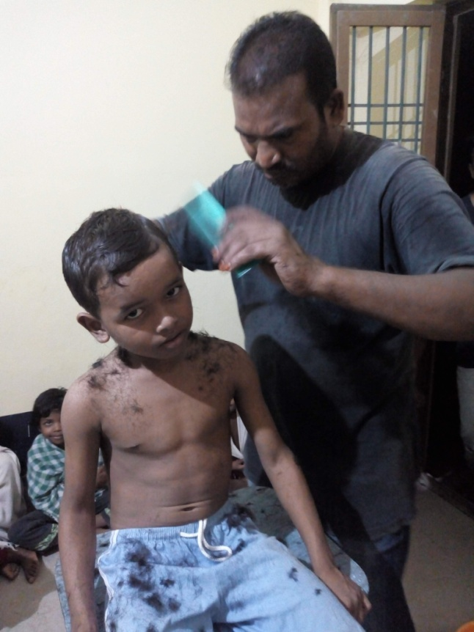
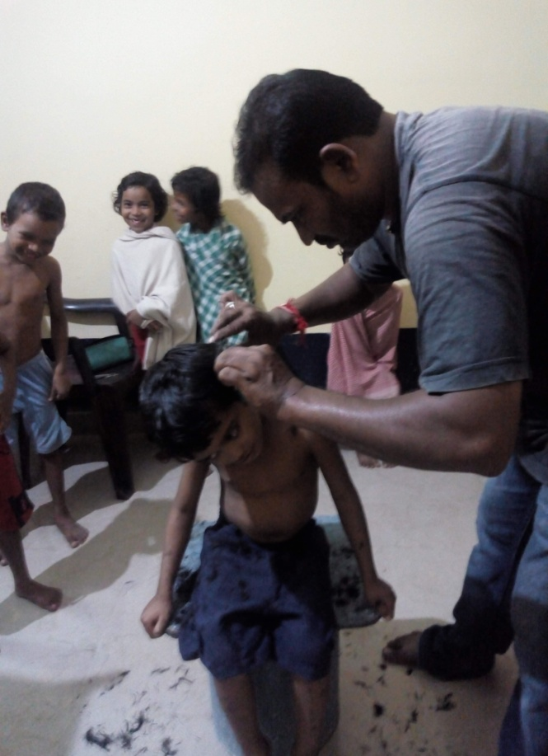
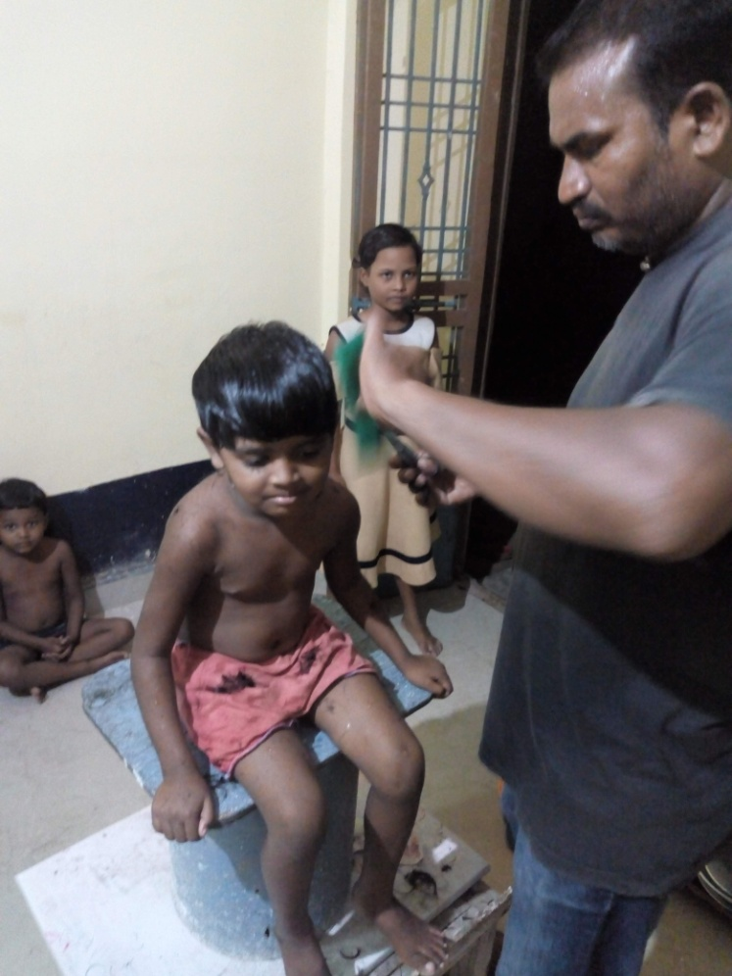
RIM – Reaching the Unreached Tribes of India
Transformation Process - 3
ABC
PROGRAM

Slide 10
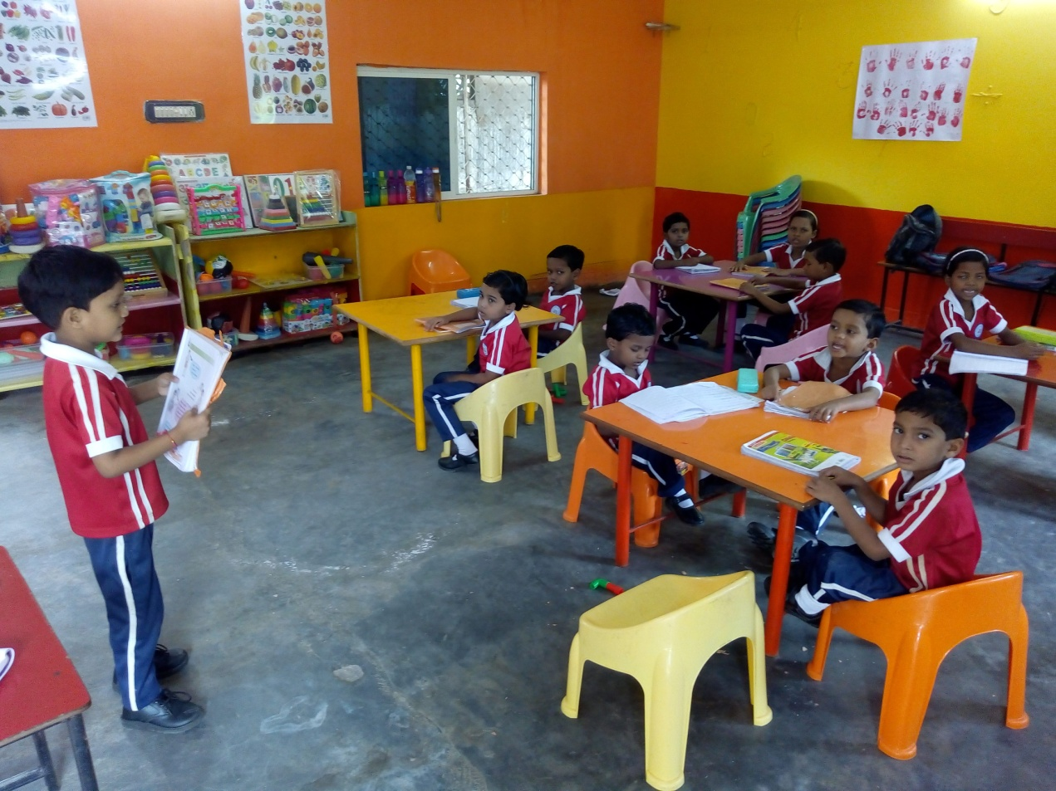
RIM – Reaching the Unreached Tribes of India
ABC
PROGRAM
Transformation Process - 4

Slide 11
RIM – Reaching the Unreached Tribes of India
Please Pray and Support Our Program in India
If Jesus can use a boy with 5 loaves of bread and 2 small fish (John 6:8-11) than we all can make a bigger difference.
Please click the “Support” button and join us for the extension of our Lords Kingdom
THANK YOU

